Slide 1


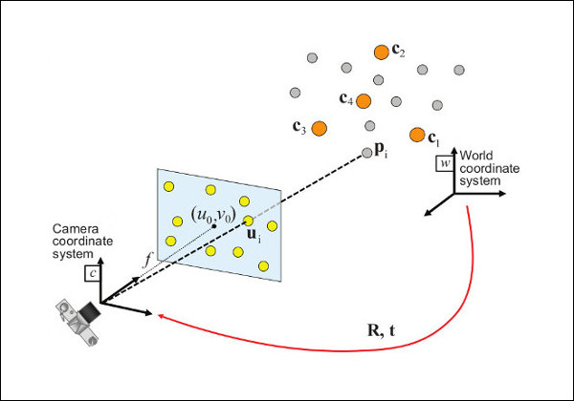
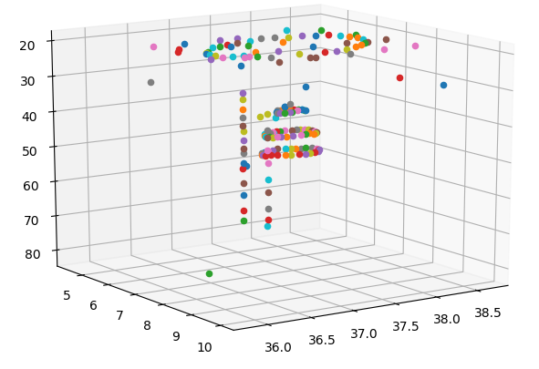
Constructing 3D Models from 2D Drone Pictures
With these complex functions and algorithms, accurate and detailed point cloud renderings and 3D reconstruction models can be calculated and projected from an album of 2D images. The downside of this technique resides in the runtime of these reconstruction software. This is a critical aspect as this software is used to assist relief crews in targeting areas in need of immediate repair and response. With more time, we as a research group would use the customized camera position calculation program to plot key features from 2D images to a 3D point cloud with reduced runtime.
3D reconstruction starts with a series of 2D images. The implementation of photogrammetry techniques help us pair similar images together to create a consistent overlap. With all images having a smooth overlap between them, key features within these images can then be projected and form a 3D cloud rendering of the targeted environment
A very important step in the reconstruction process is to figure out where and what images correlate with each other. Feature matching is the primary method to achieve this type of image pairing. Algorithms that help conduct these matches would be the SIFT and RANSAC algorithms. These algorithms detect unique edges and use different Gaussian filters to find key points between two images with seven or more inputs of data points.
Fields such as Multi-view Geometry and linear algebra are the mathematical backbone of reconstructing software. Functions such as the Fundamental and Camera matrix are responsible for calculating and estimating the camera position of each image, which in turn helps orient and create a more accurate point cloud rendering.
By Mahmoud E. Shabana,
Nianqi Tian,
Steven
Advised by Pro. Gil Eckert, Pro. Jim Nickels

